Slide 1
Deployment Diagrams
ALWOCH SOPHIA
DDIIRO JOSEPH
BALENZI PHILLIP
ASAMO ELIZABETH

Slide 2
What are they?
Deployment diagrams are used to visualize the topology of the physical components of a system (hardware), their distribution, association and where the software components are deployed.
Deployment diagrams describe the static deployment view of a system. They consist of nodes and their relationships.

Slide 3
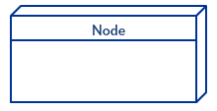
Deployment diagram notations
In order to draw a deployment diagram you need to first become familiar with the following deployment diagram notations and deployment diagram elements.
Node
A node, represented as a cube, is a physical entity that executes one or more components, subsystems or executables. A node could be a hardware or software element.

Slide 4
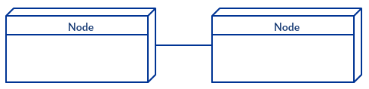
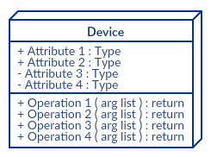
deployment diagram notations
Communication association
This is represented by a solid line between two nodes. It shows the path of communication between nodes.
Devices
A device is a node that is used to represent a physical computational resource in a system. An example of a device is an application server.

Slide 5
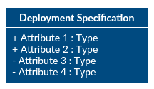

Deployment specifications
Deployment specifications is a configuration file, such as a text file or an XML document. It describes how an artifact is deployed on a node.
Artifact
Artifacts are concrete elements that are caused by a development process. Examples of artifacts are libraries, archives, configuration files, executable files etc.

Slide 6
Stakeholders
A stake holder is any person/individual that is invested or interested in the outcome of a certain project.
Below are the stake holders of the deployment diagram.
Customer.
Developer/System engineer.
User.
Product owner.

Slide 7
Importance of deployment diagrams
Visualize the hardware topology of a system.
Describe the hardware components used to deploy software.
Describe the runtime processing nodes.
An efficient deployment diagram is very important as it controls performance, scalability, maintainability and portability.
Represent the manner in which software interacts with hardware to perform a specific function.
Represent how software is installed on the hardware component.

Slide 8
Drawing a deployment diagram
Step 1:
Identify the purpose of your deployment diagram. And to do so, you need to identify the nodes and devices within the system you’ll be visualizing with the diagram.
Step 2:
Figure out the relationships between the nodes and devices. Once you know how they are connected, proceed to add the communication associations to the diagram.
Step 3:
Identify what other elements like components, active objects you need to add to complete the diagram.
Step 4:
Add dependencies between components and objects as required.

Slide 9
Example of a deployment diagram
The following example is assumed to be a web-based application, which is deployed in a clustered environment using the webserver and database server. The user connects to the application using the Internet. The control flows from the user to the clustered environment.
The following are identified as nodes; web server and database server.
The components are computer and modem while the logfile is the artifact.

Slide 10
